Slide 1

Today’s topics
Industrial license
MSME
Corporate governance
Companies Act 2013
SEBI norms
RPT: Suzuki Mehsana
Vodafone
Transfer pricing
Netherland BIPA
GAAR, DTC, UNICTRAL
Nokia: Royalty tax, Finland DTAA
All PowerPoint Slides available at Mrunal.org/ECONOMY

Slide 2
Debt vs Equity?
IIB, IINSS-C
T-Bill vs G-sec
IPO issue mechanism
Par value vs premium
ADR-GDR
Bond yield vs bond price relation

Slide 3
Preferential shares
Bonus issue
Rights issue
ETF
Hedge fund
P-notes
Call option, Put option

Slide 4
Stag investor
SENSEX formula
PAN card vs Aadhar Card
Trading softwares
FSLRC recommendations

Slide 5
Industrial Policy
1948 | Shyama Prasad Mukerjee: 1st industrial policy.
1956 | policy revised- main focus on PSU
1991 | LPG reforms, Narsimharao’s new industrial policy.

Slide 6
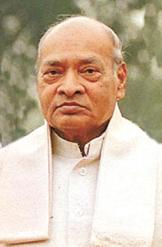
industrial policy features
1991
FDI relaxed
NRI can invest upto 100%
Software technology parks
Disinvestment of PSU, Miniratna-Navratna
MRTP act (‘69)=> CCI act (2002)

Slide 7
industrial policy features
1991
Only 3 areas reserved for Public sector:
Atomic Energy
Atomic Minerals
Rail Transport

Slide 8
industrial policy features
1991
Only 5 sectors require industrial licensing
Remaining just fillup Industrial Entrepreneur’s Memorandum (IEM) @DIPP
DIPP: Department of Industrial policy and promotion

Slide 9


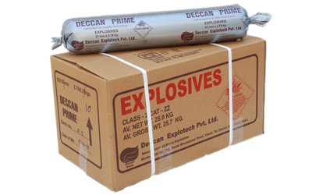


Industrial license is required for…
Tobacco & Cigar
Defense, Electronic Aerospace eqip.
Hazardous Chemicals

Slide 10

Hazardous Chemicals
License
Nitrocellulose: guncotton
Hydrocyanic acid: Prussaic acid
Phosgene: plastic, pesticides
Methyl Isocyanate (MIC): Sevin Fertilizer, Bhopal tragedy 3/12/84

Slide 11
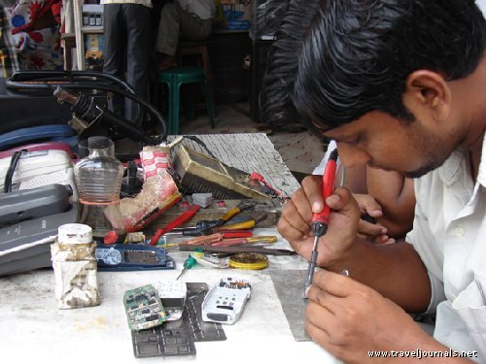
Manufacturing Policy
NMP-2011
Mfg share in GDP 15%
Increased to 25%
Create 100 million jobs
PPP, infrastructure
Skill Development: polytech.
VC for startup companies
Nat.investment & mfg zone (NIMZ)
Reform labor laws
Ignore for
Non-UPSC

Slide 12

Labor reforms
WHY?
Labor laws: concurrent list
44 union, 150+ state laws
Inspector-bribe raj
Industrial dispute act ‘47
>100 workers, Government permission before laying off
Super-contractors: no EPF, SS.
Apprentices used as regular workers

Slide 13
Labor reforms
Solution
Two bills in LS (2014, Aug)
Factories Bill
Apprentice Bill

Slide 14

Factories Act
Laws
2010: Narendra Jadhav Committee
2014: Amendment bill

Slide 15
Define Factory
criteria | 1948 | 2014
power used | 10 workers | 20
power not used | 20 workers | 40

Slide 16
Factories Bill 2014
features
Women workers can do nightshift
Safety provision and home transport
Can work on moving / heavy machinery
Exempt: PH+ mothers

Slide 17
Factories Act
features
100 hours overtime per 3 months
Min. 90 days / year to get paid leaves.
Capacity: horsepower=> kilowatts
Can decide its own workweek.

Slide 18
Factories Bill
Facilities
Cool water irrespective of #workers
Spitton, sitting facilities=> compoundable offense.
Restroom, lunchroom >75 workers
Canteen: 200> workers
Self-certification
Union can also make rules. (earlier only states)

Slide 19
Factories Bill
overall
Women equality
More safety and facilities
Owner no arrest for minor issues.

Slide 20
Apprentice Act
laws
1961 outdated law
2014 bill
Age: 14 non-hz, 18 hazardous
non-engineering graduates and diplomas can enter
Common training by multiple companies
Test by National Council for Vocational Training (NCVT).
Ignore for
Non-UPSC

Slide 21
Industrial policy
Factories act
Apprentice act
Next: MSME; => corporate sector => companies Act

Slide 22
Cottage
Village industry
Family members
No hired manpower
Capital investment negligible
Handmade products, no tools used
Area <10k population
Investment<15k / worker

Slide 23
Organized (17%)
Unorganized (83%)
Factories Act, 1948
Plantation acts
Shops and Commercial Establishments Acts of State Governments,
Industrial Employment Standing Orders Act, 1946 etc
Not covered under such acts

Slide 24
Organized (17%)
Unorganized (83%)
SS, EPF, Maternity benefit
Unorganized Workers Social Security Act 2008
Social security boards setup at national and state levels.
2010: NPS-Swavalamban scheme

Slide 25
MSME Classification: investment
 | Mfg. Sector (32%)
MICRO | upto 25 lakhs
SMALL | >25 lakhs
MED. | >5 cr. Upper limit 10 cr.

Slide 26
MSME Classification: investment
 | Mfg. Sector (32%) | Service (68%)
MICRO | upto 25 lakhs | upto 10 lakhs
SMALL | >25 lakhs | >10
MED. | >5 cr. Upper limit 10 cr. | >2 cr. upper limit 5 cr.

Slide 27
Items reserved
SSI
Pickles & chutneys Bread two edible oils (without solvent extraction) -Mustard oil, Ground nut oil Wooden furniture and fixtures Exercise books and registers Wax candles Laundry soap | Safety matches Fire works Agarbatties Glass bangles Steel almirah Rolling shutters Steel chairs, tables, furniture Padlocks utensils- stainless steel, aluminum

Slide 28
Items reserved
SSI
Non-MSME industry
Must get license + 50% export
Doesn’t apply to SEZ

Slide 29
Taxation
MSME
No excise duty: 1.5 cr turnover
No Service tax: <10 lakh /year
Capital subsidy: 15lakhs to purchase
SEDF / SIDBI
Khadi board, Coir Board, Udhyami mitra
More: Refer to Economy section

Slide 30
Public Procurement
MSME
Policy 2012: 3 years
All central Government units
20% of total purchase from MSME
Within that 4% from SC/ST
Ignore for
Non-UPSC

Slide 31


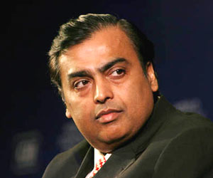
Corporate Governance
Definition
Companies Act 2013
SEBI norms 2014

Slide 32
Corporate governance: Meaning?
Way of directing the company
To protect stakeholders’ interest
To comply with legal-regulatory req.
Not mere technical compliance
Moral-ethical compliance
Absence: fraud, mismanagement
Notes:
shareholder, employees, customers, suppliers, distributors

Slide 33
Corporate governance in India
SEBI Norms:
Sep 2012: Adi Godrej
April 2014: Published
Effective 1st Oct. 2014
Companies Act
Original 1956
Aug 2013 (470 section)
…
Feb 2014: rules notified

Slide 34
Types of companies
Companies Act
2013
Public Ltd.
7-unlimited
Listed
Vodafone India.
Unlisted
Nokia-Microsoft
One person
Private ltd.
2-200
Total ~9 lakh companies
>90% private ltd.

Slide 35
Companies Act
2013
Public Ltd.
7-unlimited
One person
Private ltd.
2-200
Min.Capital 1 lakh
Min. Capital 5 lakh
Min.Capital: 1L
Convert once capital >50 or turnover >2cr.
Dec. 2014: Government wants to scrap min.capital
Counter: shell companies, money laundering

Slide 36
Infosys
1981
Private ltd
1992
public. Ltd
1993
IPO launch
Notes:
One share sells for Rs.3200

Slide 37
Companies Act
2013
Public Ltd.
7-unlimited
One person
Private ltd.
2-200
Min.Capital 1 lakh
Min. Capital 5 lakh
Min.Capital: 1L
Convert once capital >50 or turnover >2cr.

Slide 38
Holding Vs Subsidiary
Reliance industries Ltd (Holding)
Delight protein Ltd. (Subsidiary)

Slide 39
Holding vs Subsidiary Companies
GEB: Gujarat Urja Vikas Nigam Ltd. (GUVNL)
Gujarat State Electricity Corporation Limited (subsidiary)
Ukai
G'Nagar
Dhuvaran

Slide 40

Dept. undertaking
Org.
Indian Railways, Postal Department
commercial activity such as engineering, manufacturing etc.
directly controlled, just like any other department
not under the companies act
Employees = Government servant
Directly CAG + RTI

Slide 41

Public Corporations
LIC, Air India, IDBI, UTI
Act of Parliament / State Legislature
Wholly financed by Government
All BoD
Employees not Government servant
Directly by CAG (some exception)

Slide 42

Government Companies
Org.
ONGC, SAIL, Coal India ltd.
Registered under Companies Act
Government owns >50% shares
Majority BoD.
Employees Not public Govt.
CAG appointed pvt. Auditors
“Ratna” Click Me

Slide 43
Industrial licenses
MSME
Types of Companies and PSUs
NEXT: Board of Directors

Slide 44
Types of companies
Companies Act
2013
Public Ltd.
7-unlimited
Listed
Vodafone India.
Unlisted
Nokia India
One person
Private ltd.
2-200

Slide 45

MD/CEO
Executives
Staff
Board of Directors
Chairman
IPO
SHARE-HOLDERS
Notes:
Kishor Biyani, Future group, Pantaloon

Slide 46

BoD
Chairman
Executive Director/Full-time
Nominated (Bank/CG)
Independent Director

Slide 47
No. of Directors (Compulsory under Companies Act)
Companies Act
2013
Public Ltd.
7-unlimited
One person
Private ltd.
2-200
1
2
3

Slide 48
Companies Act 2013: Directors
Maximum: 15
Even more by AGM resolution
One person: maximum 20 companies.
One director Indian resident (182 days)
One director Woman
12 months absent = vacate.

Slide 49
BoD
Chairman
Executive Director/Full-time
Nominated (Bank/CG)
Independent Director

Slide 50
Companies Act 2013: Independent director
Not a Promoter
Pecuniary interest…X (except salary)
Employee…X

Slide 51
Independent Directors
Companies Act
2013
Public Ltd.
7-unlimited
One person
Private ltd.
2-200
NA
NA
1/3rd
Minimum 3=>1
Max 15=>5
Term: 5 years x 2 (performance review AGM)
Re-appointment: cooling 3 years

Slide 52
SEBI norms: ID
ID: Separate meetings
One person max. 7 companies ID
Full-time director in 1 company => 3 companies' ID
Term: 2 x 5 years (Retrospective)
Performance report on ID
Atleast 1 woman director in the board
Notes:
1st October 2014

Slide 53
Independ Directors
Board Meetings
CEO
Executives
Staff
Board of Directors
Chairman-MD
IPO
SHARE-HOLDERS
Notes:
Kishor Biyani, Future group, Pantaloon

Slide 54
Companies Act 2013 : Board meetings
Minimum 4 meetings per year
Not > 120 days gap
Video conferencing…yes
Quorum: 1/3rd strength OR 2 directors whichever max. (one person company..X)
7 days prior notice

Slide 55
Companies Act -BoD: Committee
Audit committee
Stakeholder relationship committee (SRC)
CSR committee (CSRC)
Nomination and Remuneration committee (NRC):
MD/Director: 11% of profit
CEO vs Median salary
Pay rise vs Company performance

Slide 56
Corporate Social responsibility (CSR)
Last 3 years' avg. profit=> 2% CSR spend
Applies to?
net profit of 50 million (Excluding Tax)
net worth of 5 billion (Asset-liability)
turnover of 10 billion (sales excluding costs)
Foreign branch…X

Slide 57
Independ Directors
Board Meetings
AGM
CEO
Executives
Staff
Board of Directors
Chairman-MD
IPO
SHARE-HOLDERS
Notes:
Kishor Biyani, Future group, Pantaloon

Slide 58
Annual General Meeting (AGM)
One person company: no need
Public & pvt LTD. companies…yes
General notice by letter / email
Quorum (physically present): depending on # shareholders: 5 to 30
Proxy voting….Yes
Electronic Voting…Yes (SEBI C.G. Norms also)
Notes:
1000-5 & >5000 then 30

Slide 59
Auditing related
Independent directors
Board meetings
AGM

Slide 60
Companies Act 2013
BoD => Audit Committee (ID)
External Auditors
Fraud report to Central government + shareholders' meeting
One auditor=> maximum of 20 companies

Slide 61
Companies Act 2013: Auditor’s term
Individual auditor: 5 years
Audit firm: 5 year x 2
Cooling off: 5 years
Internal audit: CA/Accountant/others
Whistleblower mechanism
Full time Company Secretary: capital >Rs.5 cr

Slide 62
Companies Act 2013: misc.
Company cannot give loan to director / related persons
Min. loan interest rate >G-Sec
Credit rating before accepting public deposit (CIS)
Chief Finance Officer=> audit account

Slide 63
Types of companies
Independent director, BoD, AGM
Audit related
Misc. loan, CIS

Slide 64
New bodies Companies Act 2013
National Company Law Tribunal (NCLT)
National Financial Reporting Authority (NFRA)
Investor and Education Protection Fund
SFIO Fraud

Slide 65
National Company Law Tribunal (NCLT)
Judicial + technical members
Finish case in three months
Appeal: NCLAT
Present case by Self, Lawyer, CA, CS
Cases:
arbitration, compromise, M&A
Converting Public ltd. To private ltd.
Filing Class action suits (Satyam)

Slide 66
#2: National Financial Reporting Authority (NFRA)
1 Chairman + 15 members
Accounting standards
Powers of civil court
Professional misconduct of CA/accountant=> debar
Appeal: NFRAA
ICAI unhappy (Chartered Accountants Act, 1949)
Notes:
SEBI=> SAT

Slide 67
New bodies Companies Act 2013
National Company Law Tribunal (NCLT)
National Financial Reporting Authority (NFRA)
Investor and Education Protection Fund
SFIO Fraud

Slide 68
Investor and Education Protection Fund
Since 1956’s company act
Unclaimed Dividend, interest, principle
Under Corporate Affairs Ministry
Awareness, seminar, financial literacy
Participation from RBI, SEBI, experts

Slide 69
Investor and Education Protection Fund Authority
2013’s Act: Statutory authority
@Delhi HQ, Regional offices
Corp. Affairs Secretary = Chairman
Members:
RBI Executive directors
SEBI Executive directors
Legal experts etc.

Slide 70
New bodies Companies Act 2013
National Company Law Tribunal (NCLT)
National Financial Reporting Authority (NFRA)
Investor and Education Protection Fund
SFIO Fraud

Slide 71
Serious Fraud Investigation Office (SFIO)
Naresh Chandra report on Corp. governance
2003: under Corp. Ministry
Cases
Satyam
Reebok fraud
Sesa Goa invoice
Saradha Chitfund

Slide 72
Companies Act 2013: SFIO
Statutory body
Not just document examination
Search seize arrest
CrPC power- investigator
Once SFIO gets case, other agencies can’t proceed.
State police, CBI -cooperate, provide documents, witnesses.

Slide 73
Companies Act: Memorize
3 companies: OPC, pvt, public
4 new bodies: tribunal, financial reporting, edu. Fund, SFIO
Directors: ID, women
Meeting: Board, AGM
Audit: fixed term, whistleblower, report to central Govt.

Slide 74
Conclusion: Companies Act 2013
business-friendly regulations
Better corporate governance
Protecting small investors
Self-regulation
Less government approval

Slide 75
Independent Directors
E-Voting
RPT- Related party transaction
Transparency
Salary Committee under ID
Audit Committee
Whistleblowers
SEBI Norms
Minority shareholders
Adi Godrej
1st October 2014
Notes:
Related party transaction
1st October 2014

Slide 76

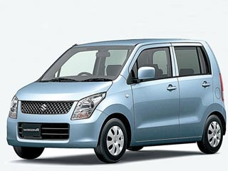

Maruti Suzuki Gujarat plant Controversy

Slide 77

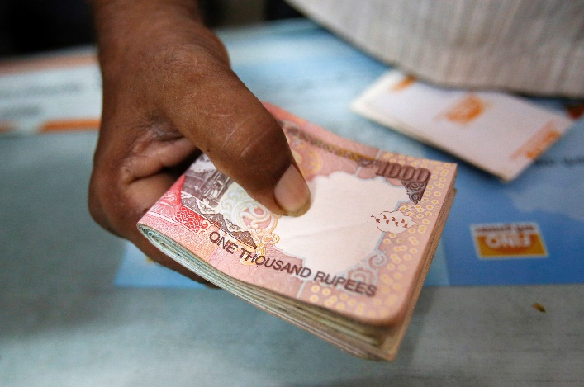
Royalty Payment
Dividend
Dividend
HARYANA
Notes:
Suzuki 56%

Slide 78
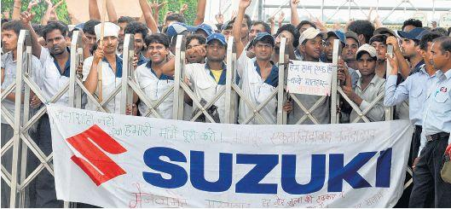
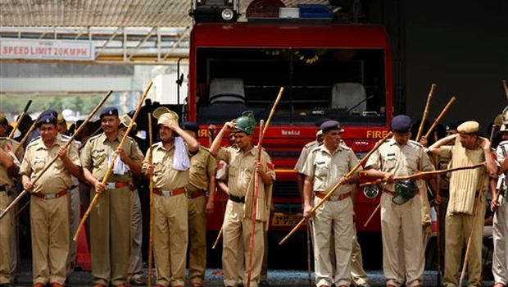
MANESAR UNREST, 2012
1 Manager dead
2 Japanese Executive injured
Rs. >3000 crore

Slide 79
Profit
Dividend
Dividend
Suzuki
Motors
Gujarat
Royalty Payment
Cost price
Profit margin
Mehsana
Notes:
Suzuki 56%

Slide 80
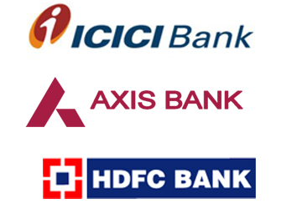
Why controversy?
HDFC, Reliance Cap, ICICI, SBI
Suzuki (56%)
Less profit for MS=>less dividend
MS. Will become mere distributor/ marketing company.

Slide 81
HDFC, Reliance Cap, ICICI, SBI
Suzuki (56%)
Maruti-Suzuki has surplus of Rs.7500 cr.
Why not upgrade Haryana?
100% subsidiary in Gujarat
15 years lease
If not renewed, it’ll be merged with Maruti-Suzuki.
(2017) 25-30k Cr.

Slide 82
Why controversy?
HDFC, Reliance Cap, ICICI, SBI
Suzuki (56%)
Why not upgrade Haryana?
Profit re-invested in Gujarat
@Haryana 1.5 million cars / PA
@Gujarat 2.5 million (2017)
No Risk for Maruti

Slide 83

Gujarat positive Points
Maruti
Mehana ~1200 Acre.
640 acres in Becharaji ; 550 acres in Vithalapur
Investment of Rs. 25-30k Cr.
Full Capacity in 2017
2.5 million cars /PA
Autohub- replacing Tamilnadu +Haryana
Suzuki Motors Gujarat ltd=>Ahmedabad (HQ)
EMPLOYMENT
Notes:
Employment

Slide 84
Negative for Suzuki
Mehsana
Companies Act 2013 =>1/4/2014.
“Related party Transaction” RPT
Require vote from majority of minority shareholders.
Minority shareholders=> SEBI complaint

